Slide 1
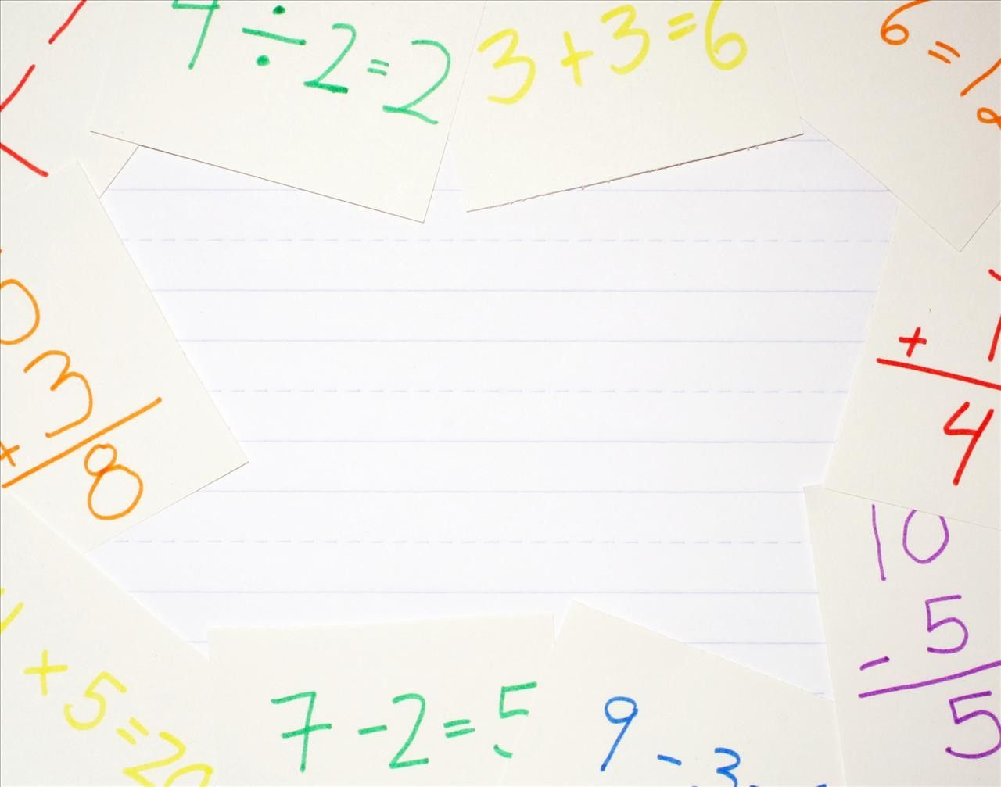
INTRODUCTION TO INTEGERS

Slide 2
INTEGERS
INTEGERS ARE THE NUMBERS WHICH INCLUDES NEGATIVE OF NATURAL NUMBERS WITH THE GROUP OF WHOLE NUMBERS.
EG.OF NUMBERS LIKE-3,-2,-1,0,1,2,3,4. THESE NUMBERS ARE KNOWN AS INTEGERS.
IT IS DENOTED AS I OR Z

Slide 3
TYPES OF INTEGERS
POSITIVE INTEGERS ARE 1,2,3,4,5
NEGATIVE INTEGERS ARE -4,-3,-2,-1
0 IS NEITHER POSITIVE INTEGER NOR NEGATIVE INTEGER

Slide 4
USES OF INTEGERS
IT CAN BE USED IN :-
BUSINESS
BANKS
TEMPERATURE IN THERMOMETERS
HEIGHT OF SEA LEVEL

Slide 5
ABSOLUTE VALUE OF AN INTEGER
THE ABSOLUTE VALUE OF A NUMBER IS ALWAYS A POSITIVE NUMBER
IT IS DENOTED BY X.
-5,5 IT WILL BE WRITTEN AS 5 FOR EG ABSOLUTE VALUE OF -8 IS |-8 |=8 ,75 IS |75| =75

Slide 6
ADDITIVE INVERSE
FOR EVERY POSITIVE INTEGER THERE IS A NEGATIVE INTEGER WHICH LIES AT THE EXACT SAME DISTANCE FROM ZERO IN THE OPPOSITE DIRECTION.
THE TWO NUMBERS ARE KNOWN AS ADDITIVE INVERSE OF EACH OTHER.
SUM OF A NUMBER AND ITS ADDITIVE INVERSE WILL ALWAYS BE ZERO
FOR EG – 28 ADDITIVE INVERSE OF-28 =28+[-28] =0 SO THE ADDITIVE INVERSE OF 28 IS -28

Slide 7
COMPARING INTEGERS.
LET D AND E BE TWO INTEGERS. PLOT THESE INTEGERS ON THE NUMBER LINE
IF D IS ON THE RIGHT OF E ON THE NUMBER LINE, THEN D IS GREATER THAN E
IT IS DENOTED BY D>E
IF D IS ON LEFT OF E ON THE NUMBER LINE,THEN D IS SMALLER THEN E
IT IS DENOTED BY D<E
IF D AND E ARE AT THE SAME POINT ON THE NUMBER LINE, THEN D AND E ARE EQUAL. IT IS DENOTED BY D=E

Slide 8
_
ORDERING INTEGERS
FIRST SEPARATE THE NEGATIVE AND POSITIVE INTEGERS
COMBINE NEGATIVE AND POSITIVE SERIES
FOR ASCENDING ORDER KEEP THE NEGATIVE NUMBERS ON THE LEFT SIDE POSITIVE NUMBERS ON THE RIGHT SIDE.
FOR DESCENDING ORDER KEEP THE NEGATIVE NUMBERS ON THE RIGHT SIDE AND POSITIVE NUMBERS ON THE LEFT SIDE .
IF ZERO IS GIVEN THEN KEEP THE ZERO IN THE MIDDLE OF NEGATIVE AND POSITIVE NUMBERS.

Slide 9
ASCENDING ORDER
FOR E.G.ASCENDING ORDER- -13,25,0,-25,-12,16,32,-4 -20,30
POSITIVE INTEGERS- 25,16,32,30
NEGATIVE INTEGERS -13,-25, -12,-4 ,-20
ASCENDING ORDER OF THE NEGATIVE INTEGERS IS -25< -20< -13<-12<-4
ASCENDING ORDER OF THE POSITIVE NUMBER IS 16 < 25 < 30 < 32
SO, ASCENDING ORDER OF ALL THE GIVEN INTEGERS ARE -25 <-20<-13 <-12 <-4 < 0 <16 <25 <30 < 32

Slide 10
DESD
DESCENDING ORDER
FROM THE PREVIOUS EXAMPLE, WE WILL ARRANGE THE SAME NUMBERS IN DESCENDING ORDER.
WE CAN WRITE THESE INTEGERS IN DESCENDING ORDER AS :32 >30 >25 >16 >0 > -4 >-12>-13 >-20 >-25

Slide 11
QUESTIONS
Q1 WRITE THE ADDITIVE INVERSE OF THE FOLLOWING INTEGERS
1. 560=
2. -345=
3. 0=
4. +205=
Q 2 ARRANGE THE FOLLOWING INTEGERS IN ASCENDING ORDER
1. -23, 54,76,-34 ,-23 ,2, 87,-97,0, -54
2.-16,-18,15,-20,5,-17,-12,16,-8
Q 3 ARRANGE THE FOLLOWING INTEGERS IN DESCENDING ORDER
1. 76, -6,53, -34, -23,2, 87,-98
2. 0, -59,70,32,-45,88,9,51,-35
Q 4 COMPARING INTEGERS PUT >,= OR ,<
1. -16_____ -18 2. 0______-5 3. -11______ -9
ASCENDING AND DESCENDING ORDER

